Slide 1
CS 176c Discussion Session 4/10
TA: Vivek Adarsh

Slide 2
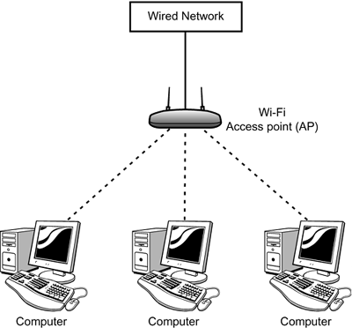
Review Questions
What does it mean for a wireless network to be operating in “infrastructure mode?”
In infrastructure mode of operation, each wireless host (end device) is connected to a base station, or an access point, through which the larger network is connected to.

Slide 3
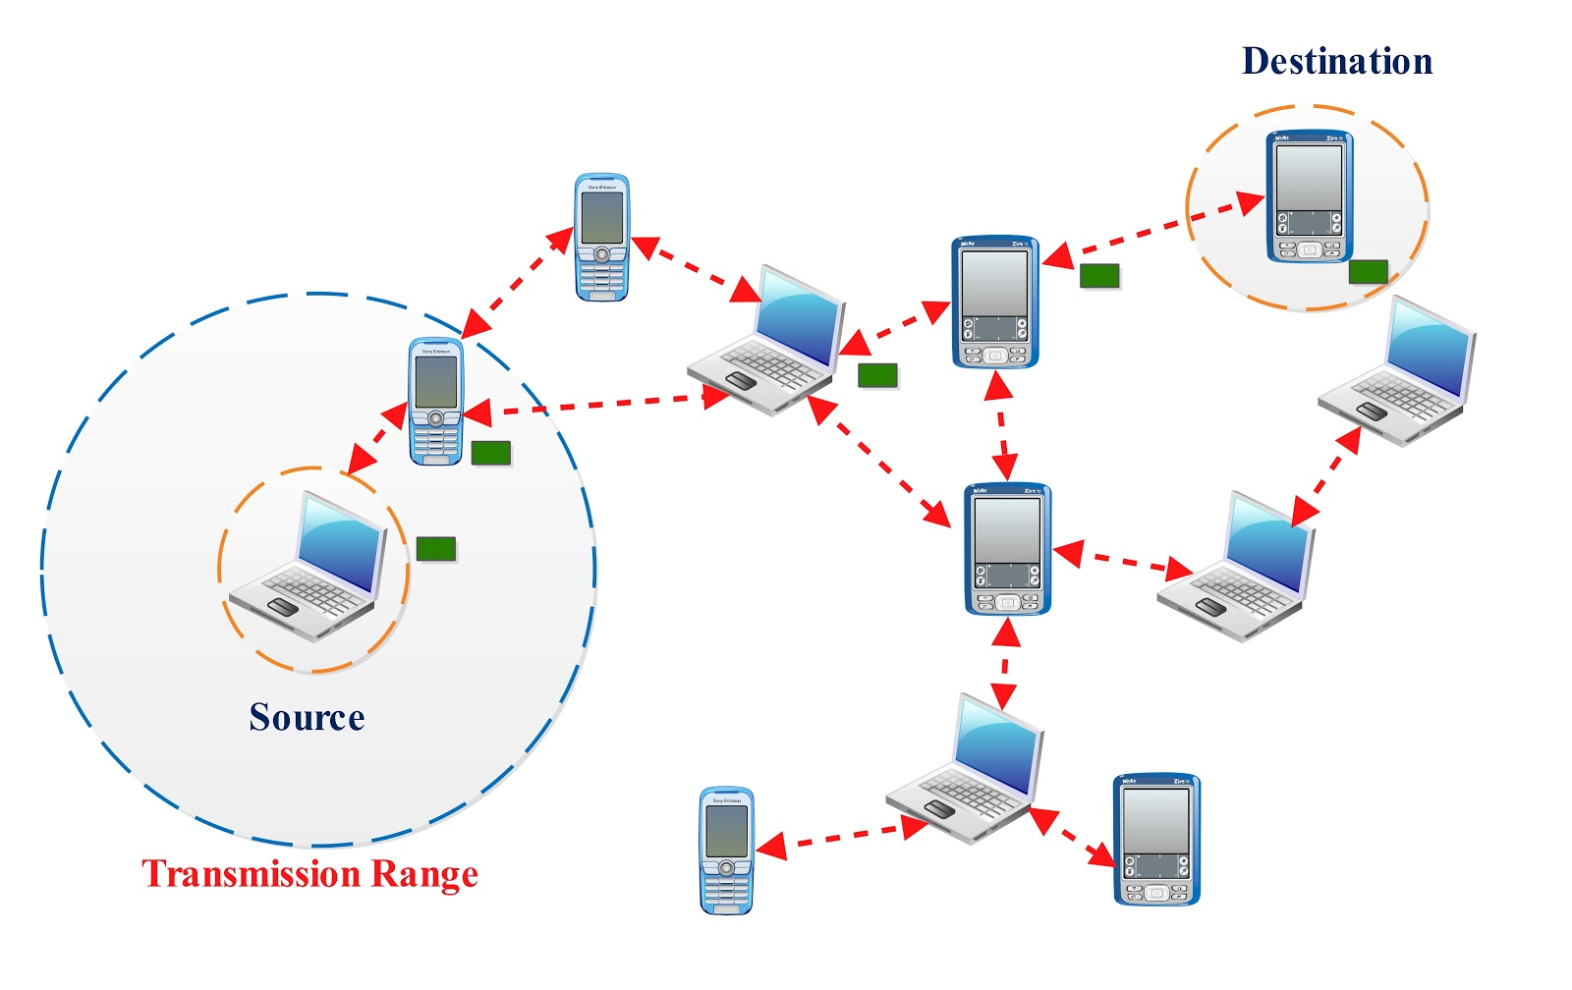
Review Questions
If the network is not in infrastructure mode, what mode of operation is it in, and what is the difference between that mode of operation and infrastructure mode?
If not operating in infrastructure mode, a network operates in ad-hoc mode. In ad-hoc mode, wireless hosts have no infrastructure with which to connect. In the absence of such infrastructure, the hosts themselves must provide for services such as routing, address assignment, DNS-like name translation, and more.

Slide 4
Review Questions
What are the four types of wireless networks identified in our taxonomy in Section 7.1? Which of these types of wireless networks have you used?
Single hop, infrastructure-based
Single hop, infrastructure-less
Multi-hop, infrastructure-based
Multi-hop, infrastructure-less

Slide 5
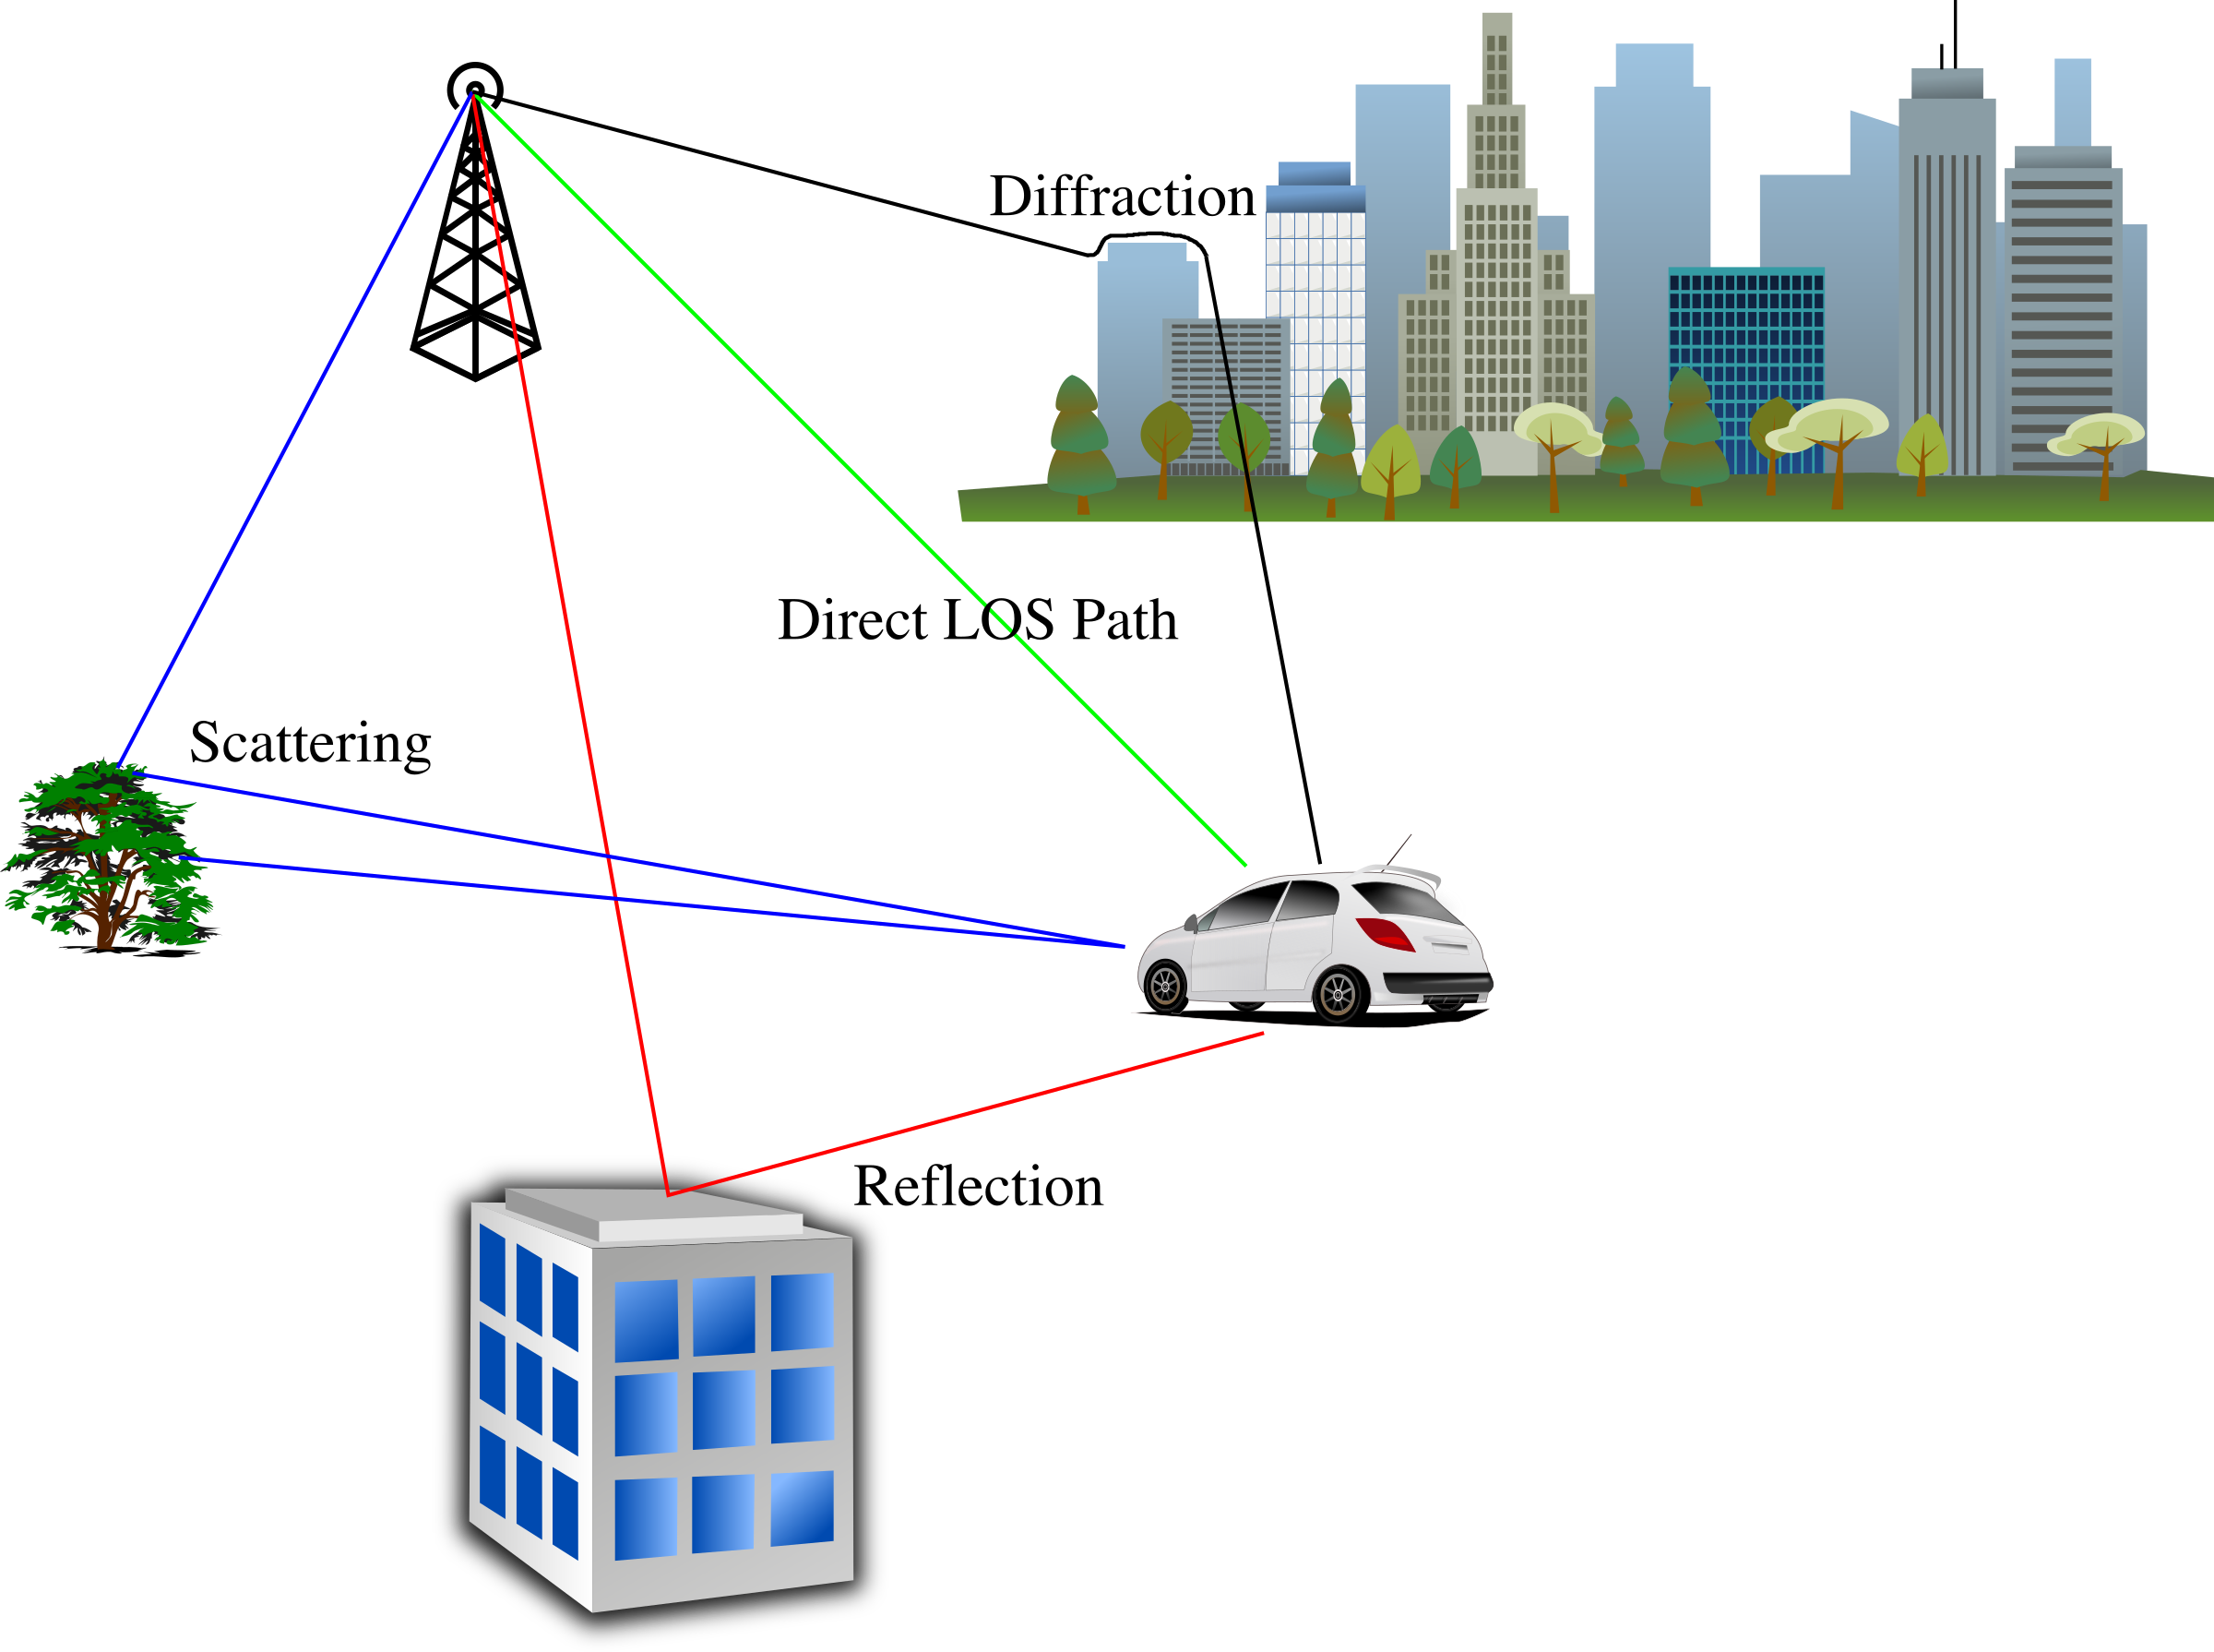
Review Questions
What are the differences between the following types of wireless channel impairments: path loss, multipath propagation, interference from other sources?
Path loss is due to the attenuation of the electromagnetic signal when it travels through matter.
Multipath propagation results in blurring of the received signal at the receiver and occurs when portions of the electromagnetic wave reflect off objects and ground, taking paths of different lengths between a sender and receiver.
Interference from other sources occurs when the other source is also transmitting in the same frequency range as the wireless network.

Slide 6
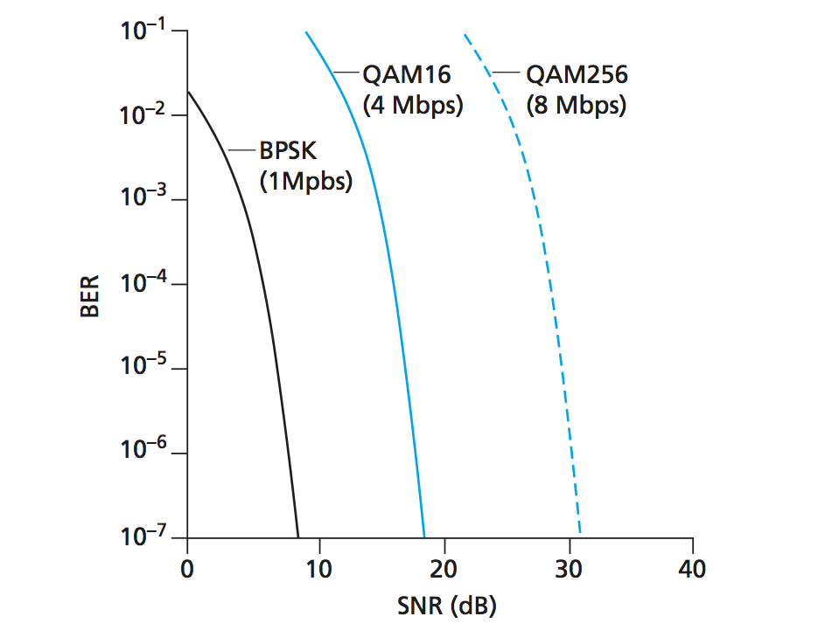
Review Questions
As a mobile node gets farther and farther away from a base station, what are two actions that a base station could take to ensure that the loss probability of a transmitted frame does not increase?
Increasing the transmission power
Reducing the transmission rate
For reference only

Slide 7
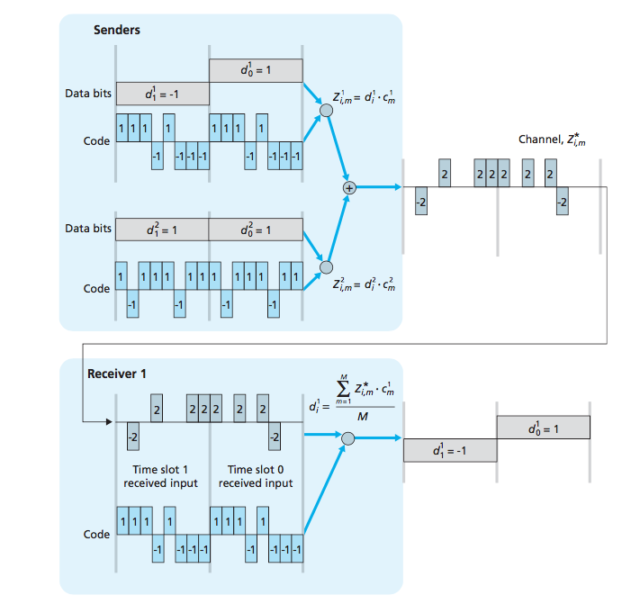
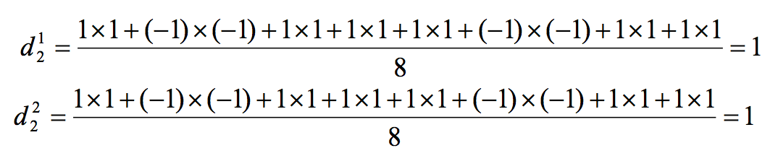
Problems
Suppose that the receiver in Figure 7.6 wanted to receive the data being sent by sender 2. Show (by calculation) that the receiver is indeed able to recover sender 2’s data from the aggregate channel signal by using sender 2’s code.

Slide 9
Problems
In step 4 of the CSMA/CA protocol, a station that successfully transmits a frame begins the CSMA/CA protocol for a second frame at step 2, rather than at step 1. What rationale might the designers of CSMA/CA have had in mind by having such a station not transmit the second frame immediately (if the channel is sensed idle)?

Slide 10
CSMA/CA
If initially the station senses the channel idle, it transmits its frame after a short period of time known as the Distributed Inter-frame Space (DIFS)
Otherwise, the station chooses a random backoff value using binary exponential backoff and counts down this value when the channel is sensed idle. While the channel is sensed busy, the counter value remains frozen.
When the counter reaches zero (note that this can only occur while the channel is sensed idle), the station transmits the entire frame and then waits for an acknowledgment.
If an acknowledgment is received, the transmitting station knows that its frame has been correctly received at the destination station. If the station has another frame to send, it begins the CSMA/CA protocol at step 2. If the acknowledgment isn’t received, the transmitting station reenters the backoff phase in step 2, with the random value chosen from a larger interval.

Slide 11
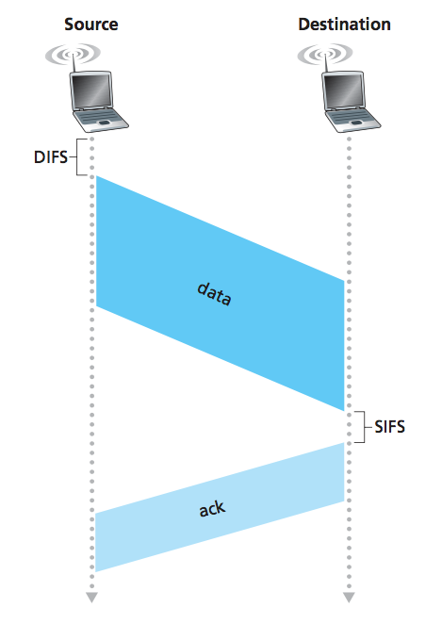
Suppose that wireless station H1 has 1000 long frames to transmit. (H1 may be an AP that is forwarding an MP3 to some other wireless station.) Suppose initially H1 is the only station that wants to transmit, but that while half-way through transmitting its first frame, H2 wants to transmit a frame. For simplicity, also suppose every station can hear every other station’s signal (that is, no hidden terminals). Before transmitting, H2 will sense that the channel is busy, and therefore choose a random backoff value.
Now suppose that after sending its first frame, H1 returns to step 1; that is, it waits a short period of times (DIFS) and then starts to transmit the second frame. H1’s second frame will then be transmitted while H2 is stuck in backoff, waiting for an idle channel. Thus, H1 should get to transmit all of its 1000 frames before H2 has a chance to access the channel. On the other hand, if H1 goes to step 2 after transmitting a frame, then it too chooses a random backoff value, thereby giving a fair chance to H2. Thus, fairness was the rationale behind this design choice.

Slide 12
Problem 8
Consider the scenario shown in Figure 7.34, in which there are four wireless nodes, A, B, C, and D. The radio coverage of the four nodes is shown via the shaded ovals; all nodes share the same frequency. When A transmits, it can only be heard/received by B; when B transmits, both A and C can hear/receive from B; when C transmits, both B and D can hear/receive from C; when D transmits, only C can hear/receive from D.
Suppose now that each node has an infinite supply of messages that it wants to send to each of the other nodes. If a message’s destination is not an immediate neighbor, then the message must be relayed. For example, if A wants to send to D, a message from A must first be sent to B, which then sends the message to C, which then sends the message to D. Time is slotted, with a message transmission time taking exactly one time slot, e.g., as in slotted Aloha. During a slot, a node can do one of the following: (i) send a message; (ii) receive a message (if exactly one message is being sent to it), (iii) remain silent. As always, if a node hears two or more simultaneous transmissions, a collision occurs and none of the transmitted messages are received success- fully. You can assume here that there are no bit-level errors, and thus if exactly one message is sent, it will be received correctly by those within the transmission radius of the sender.

Slide 13
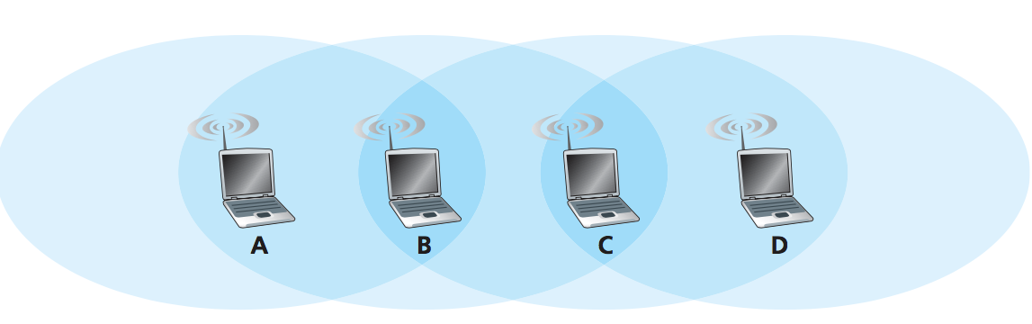
Problem 8
Suppose now that an omniscient controller(i.e. a controller that knows the state of every node in the network) can command each node to do whatever it (the omniscient controller) wishes, i.e., to send a message, to receive a message, or to remain silent. Given this omniscient controller, what is the maximum rate at which a data message can be transferred from C to A, given that there are no other messages between any other source/destination pairs?
Answer: 1 message/ 2 slots
Same message has to travel from C to B and B to A

Slide 14
Problem 8
Suppose now that A sends messages to B and D sends messages to C. What is the combined maximum rate at which data messages can flow from A to B and from D to C?
Answer: 2 messages/slot
No interference, so simultaneous transmissions allowed

Slide 15
Problem 8
Suppose now that A sends messages to B , and C sends messages to D. What is the combined maximum rate at which data messages can flow from A to B and from C to D?
2 messages/2 slots -> 1 message/slot
Collisions could happen, so we require two sequential slots

Slide 16
Problem 8
Suppose now that the wireless links are replaced by wired links. Repeat questions (a) through (c) again in this wired scenario.
1 message/slot
2 messages/slot
2 messages/slot

Slide 17
Problem 8
Now suppose we are again in the wireless scenario and that for every data message sent from source to destination, the destination will send an ACK message back to the source (e.g., as in TCP). Also suppose that each ACK message takes up one slot. Repeat questions (a) – (c) above for this scenario.
1 message/4 slots
2 messages/ 3 slots
slot 1: Message A→ B, message D→ C
slot 2: Ack B→ A
slot 3: Ack C→ D
2 messages/3 slots
slot 1: Message C→ D
slot 2: Ack D→C, message A→ B
slot 3: Ack B→ A

Slide 18
Any Questions?

